Slide 1
Similarity in shapes
Geometrical properties and Pythagoras’ theorem

Slide 2
how to use Oak lessons

Slide 3
I can recognise that similar shapes have sides in proportion to each other but angles sizes are preserved.

Slide 4
The object is the starting figure before a transformation has been applied.
The image is the resulting figure after a transformation has been applied.
Two shapes are similar if the only difference between them is their size. Their side lengths are in the same proportions.
Scale factor is the multiplier between similar shapes that describes how large one shape is compared to the other.
A property of a shape is invariant if that property has not changed after the shape is transformed.

Slide 5

Similarity in shapes
Identifying whether shapes are similar
Finding similar shapes in complex diagrams

Slide 6
Identifying whether shapes are similar
When one shape is an enlargement of another, they are similar.
example:
non-example:
18 cm
18 cm
× 2
× 2
9 cm
9 cm
× 2
× 3
3 cm
6 cm
3 cm
9 cm
The triangles are similar.
The triangles are not similar.

Slide 7
Identifying whether shapes are similar
When two shapes are similar, their lengths are in the same proportion.
example:
non-example:
12 cm
12 cm
9 cm
9 cm
× 3
× 2
× 3
× 3
3 cm
4 cm
3 cm
6 cm
The triangles are similar.
The triangles are not similar.

Slide 8


Identifying whether shapes are similar
When two shapes are similar, the angles are the same in each shape and their lengths are in the same proportion.
example:
the same angles
100°
3 cm
the same proportions between lengths
80°
4 cm
100°
The shapes are similar.
6 cm
80°
8 cm

Slide 9

Identifying whether shapes are similar
When two shapes are similar, the angles are the same in each shape and their lengths are in the same proportion.
non-example:
not the same angles
100°
3 cm
the same proportions between lengths
80°
4 cm
130°
The shapes are not similar.
6 cm
50°
8 cm

Slide 10

Identifying whether shapes are similar
When two shapes are similar, the angles are the same in each shape and their lengths are in the same proportion.
non-example:
the same angles
100°
3 cm
not the same proportions between lengths
80°
4 cm
100°
The shapes are not similar.
6 cm
80°
10 cm

Slide 11
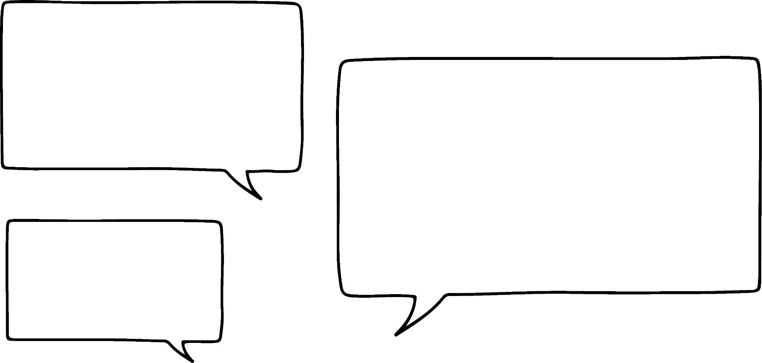

Identifying whether shapes are similar
Sofia is trying to justify why the two shapes below are not similar.
100°
80°
3 cm
I can see that they are not similar, but they have the same angles. Also the lengths shown are in the same proportion.
80°
100°
4 cm
100°
100°
6 cm
80°
80°
Why are the shapes not similar?
8 cm

Slide 12
Identifying whether shapes are similar
Sofia is trying to justify why the two shapes below are not similar.
100°
80°
While the two shapes have the same angles, they’re not in the same order.
3 cm
80°
100°
4 cm
100°
100°
Shape A:
100°, 80°, 100°, 80°
6 cm
Shape B:
100°, 100°, 80°, 80°
80°
80°
8 cm

Slide 13
Identifying whether shapes are similar
Sofia is trying to justify why the two shapes below are not similar.
100°
80°
Shape B has two consecutive angles that are 100°, but Shape A does not.
3 cm
80°
100°
4 cm
100°
100°
Shape A:
100°, 80°, 100°, 80°
6 cm
Shape B:
100°, 100°, 80°, 80°
80°
80°
8 cm

Slide 14
Identifying whether shapes are similar
Sofia is trying to justify why the two shapes below are not similar.
100°
80°
Even if I went anti-clockwise around Shape B, the angles would still be in a different order to Shape A.
3 cm
80°
100°
4 cm
100°
100°
Shape A:
100°, 80°, 100°, 80°
6 cm
Shape B
100°, 100°, 80°, 80°
80°
80°
When shapes are similar, the angles are preserved and in the same order.
8 cm

Slide 15
Identifying whether shapes are similar
If two shapes have the same angles, then they must be similar.
If the angles are the same then it means that the lengths are also in the same proportion.
If a shape has four or more vertices, then the angles may not be in the same order.

Slide 16
Identifying whether shapes are similar
If two shapes do not have the same angles, then they are not similar.
It is not possible for all of lengths to be in the same proportions if the angles are not the same.
Some of the lengths can still be in the same proportion even though the angles are not the same.

Slide 17
Identifying whether shapes are similar
A ratio table can help find proportions between lengths within shapes and find scale factors between similar shapes.
example:
100°
Shape A | 4 | 3
Shape B | 8 | 6
A
3 cm
× 2
× 2
80°
4 cm
100°
B
6 cm
This might not always be necessary, but could help for more complex cases.
80°
8 cm

Slide 18

Identifying whether shapes are similar
Laura draws three similar rectangles. She measures some of the lengths and width and fills them in on a ratio table.
What is the length of rectangle B?
24 cm
rectangle | length (cm) | width (cm)
A | 6 | 2
B |  | 8
C | 15
24

Slide 19
Identifying whether shapes are similar
Laura draws three similar rectangles. She measures some of the lengths and width and fills them in on a ratio table.
What is the width of rectangle C?
5 cm
rectangle | length (cm) | width (cm)
A | 6 | 2
B | 24 | 8
C | 15
5

Slide 20
Identifying whether shapes are similar
1) Are the two shapes below similar? Justify your answer with reasoning.
116°
6 m
135°
72°
135°
4 m
127°
116°
8 m
72°
127°
3 m

Slide 21




Identifying whether shapes are similar
2) Alex, Izzy, Jun and Sam have drawn some quadrilaterals.
My quadrilateral is similar to Alex’s and all of the edges are twice the length.
This is my quadrilateral.
60°
120°
4 cm
Alex
120°
60°
Izzy
6 cm
My quadrilateral is not similar to Alex’s, even though all the all the edges twice the length.
My quadrilateral is not similar to Alex’s, even though all the angles are the same.
Jun
Sam
Sketch a possible quadrilateral for Izzy, Jun and Sam.

Slide 22
Identifying whether shapes are similar
1) Are the two shapes below similar? Justify your answer with reasoning.
116°
6 m
135°
72°
135°
4 m
127°
127°
8 m
116°
72°
3 m
Shape A’s angles: 72°, 127°, 116°, 90°, 135°
The angles are not in the same order, so the shapes are not similar.
Shape B’s angles: 72°, 127°, 90°, 116°, 135°

Slide 23
Identifying whether shapes are similar
2) Alex, Izzy, Jun and Sam have drawn some quadrilaterals.
My quadrilateral is similar to Alex’s and all of the edges are twice the length.
This is my quadrilateral.
60°
120°
4 cm
Alex
120°
60°
Izzy
6 cm
My quadrilateral is not similar to Alex’s, even though all the edges twice the length.
My quadrilateral is not similar to Alex’s, even all the angles are the same.
Jun
Sam
Sketch a possible quadrilateral for Izzy, Jun and Sam.

Slide 24
Identifying whether shapes are similar
My quadrilateral is similar to Alex’s and all of the edges are twice the length.
My quadrilateral is not similar to Alex’s, even though all the edges are twice the length.
My quadrilateral is not similar to Alex’s, even though all the angles are the same.
Jun
8 cm
8 cm
Izzy
Sam
60°
120°
8 cm
120°
120°
12 cm
120°
60°
12 cm
60°
60°
12 cm

Slide 25
Similarity in shapes
Identifying whether shapes are similar
Finding similar shapes in complex diagrams

Slide 26
Finding similar shapes in complex diagrams
Similar shapes have the same angles. Triangles that have the same angles are similar.

Slide 27
Finding similar shapes in complex diagrams
∆ABE and ∆ACD are similar and in the same orientation.
How could this fact be used to show that BE and CD are parallel?
A
B
C
∠ABE = ∠ACD
E
∠CDE = ∠BEA
Corresponding angles are equal when on parallel lines.
Therefore BE and CD are parallel.
D

Slide 28
Finding similar shapes in complex diagrams
Facts about angles in parallel lines can be used to show that two triangles are similar.
A
∆ABE and ∆ACD both contain ∠EAB.
∠ABE = ∠BCD because corresponding angles in parallel lines are equal.
∠CDE = ∠BEA because corresponding angles in parallel lines are equal.
E
B
∆ABE and ∆ACD have the same angles, so they are similar.
D
C

Slide 29
Finding similar shapes in complex diagrams
Prove that ∆ABE and ∆BCD are similar.
A
∠EAB = ∠CDB because alternate angles in parallel lines are equal.
∠BCD = ∠BEA because alternate angles in parallel lines are equal.
C
B
∠ABE = ∠DBC because vertically opposite angles are equal.
E
∆ABE and ∆BCD have the same angles, so they are similar.
D

Slide 30
Finding similar shapes in complex diagrams
Which angle is equal to ∠CAB?
A
B
alternate angles in parallel lines
∠CDE
∠DEC
C
∠ECD
E
D

Slide 31
Finding similar shapes in complex diagrams
Which angle is equal to ∠BCD?
A
corresponding angles on parallel lines
∠ABE
2 cm
E
B
∠BEA
8 cm
∠EAB
D
C

Slide 32
Finding similar shapes in complex diagrams
Knowing which angles are equal can help identify corresponding lengths between similar triangles.
Find the length of AE. All lengths are given in cm.
A
AE is between an angle with one arc and an angle with two arcs,
12
so it is an enlargement of CD.
EB is between an angle with three arcs and an angle with two arcs,
B
4
C
so it is an enlargement of BC.
5
E
8
scale factor = 8 ÷ 4 = 2
D
AE = 5 × 2 = 10 cm

Slide 33
Finding similar shapes in complex diagrams
When solving problems involving nested similar triangles, it can be helpful to draw the two triangles separately.
Find the length of AD. All lengths are given in cm.
5
10
5
15
A
B
C
A
B
A
C
4
4
E
E
scale factor = 15 ÷ 5 = 3
D
AD = 4 × 3 = 12 cm
D

Slide 34
Finding similar shapes in complex diagrams
When solving problems involving nested similar triangles, it can be helpful to draw the two triangles separately.
Find the length of ED. All lengths are given in cm.
5
10
5
15
A
B
C
A
B
A
C
4
4
E
E
12
8
ED = AD − AE
= 12 − 4 = 8 cm
D
D

Slide 35
Finding similar shapes in complex diagrams
Which edge in ∆CDE is an enlargement of AC?
A
B
CD
DE
C
EC
E
D

Slide 36
Finding similar shapes in complex diagrams
Find the length of CD.
A
B
4 cm
6 cm
12 ÷ 6 = 2
4 × 2 = 8 cm
C
12 cm
E
D

Slide 37
Finding similar shapes in complex diagrams
1) Find the value of each unknown.
12 cm
4 cm
24 cm
5 cm
a cm
b cm
18 cm
12 cm
c cm
60°
6 cm
12 cm
15 cm
10 cm
60°
d cm
5 cm
3 cm
30°

Slide 38
Finding similar shapes in complex diagrams
2) Take a piece of paper and fold it, as shown below.
The paper that does not overlap makes four triangles.
Prove that these four triangles are all similar.

Slide 39
Finding similar shapes in complex diagrams
1) Find the value of each unknown.
12 cm
4 cm
24 cm
5 cm
a cm
b cm
a = 15 cm
18 cm
b = 16 cm
12 cm
c cm
60°
6 cm
12 cm
15 cm
10 cm
d = 4 cm
60°
d cm
5 cm
3 cm
30°
c = 20 cm

Slide 40
Finding similar shapes in complex diagrams
2) Take a piece of paper and fold it, as shown below.
The paper that does not overlap makes four triangles.
Prove that these four triangles are all similar.

Slide 41
Finding similar shapes in complex diagrams
(90 - x)°
Each triangle contains a right angle from the four corners of the paper.
x°
x°
x°
Let one angle be x°.
Angles in a triangle sum to 180°.
x°
180 − 90 − x ≡ 90 − x
Vertically opposite angles are equal.
(90 - x)°
Angles in a triangle sum to 180°.
(90 - x)°
180 − 90 − (90 − x) ≡ x
All four triangles contain the same angles, so they are all similar.

Slide 42
Similarity in shapes
Two shapes are only similar if the multiplicative relationship between corresponding edges is the same for every pair of corresponding edges.
The angles are invariant between similar shapes.
Similar shapes are not always easy to spot.
A ratio table can help you find the scalar and functional multipliers in similar shapes.

Slide 43

© Oak National Academy 2024.
Produced in partnership with Mathematics in Education and Industry.
Licensed on the Open Government Licence v3.0, except where otherwise stated. See Oak terms and conditions.

